Slide 1
Mixed Martial Arts
Louis

Slide 2
What is it?

Slide 3
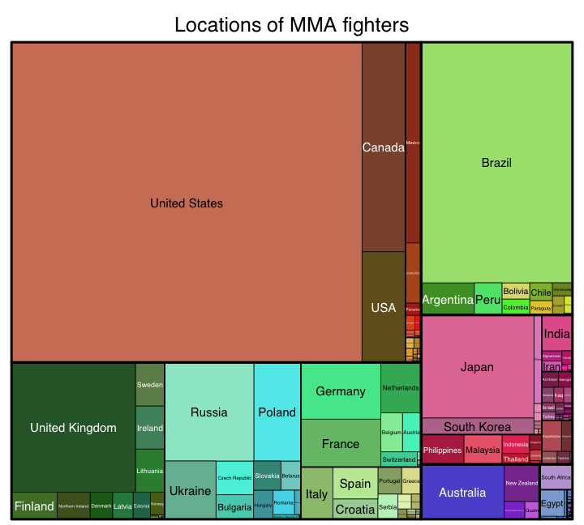
What is it?

Slide 4
What is it?

Slide 5
Major Players
UFC (+Pride, WEC, Strikeforce)
Bellator MMA
ONE championship
World series of fighting
Invicta fc
Rizin fighting federation
Etc...

Slide 6
Business Q. – Initial Thoughts
Based on a fighter’s attributes, can you determine whether he/she would be victorious before he/she enters the ring?
Are there attributes which gives a fighter the “extra edge”? (E.g. does having longer arms make you a better fighter?)

Slide 7
Data
Data on MMA fighters/Fights not readily available
The sport is still in its Infancy
Many leagues of different sizes with different rules
http://www.fightmetric.com/
…Started in 2007, FightMetric® is the world’s only comprehensive mixed martial arts statistics and analysis provider, and is the official statistics provider of the UFC®…
http://www.sherdog.com/
Sherdog is an American website devoted to the sport of mixed martial arts. The site is a member of the Crave Online network and provides MMA related content for ESPN.com.

Slide 8
Data Investigation
...Example...

Slide 9
Data Investigation
Details about the fight | FIGHT ORDER
 | KEY
 | ROUND FORMAT
 | EVENT_TYPE
 | EVENT_NAME
 | EVENT_YEAR
 | EVENT_MONTH
 | EVENT_DAY
 | LOCATION COUNTRY
 | LOCATION CITY
 | VENUE
 | ATTENDANCE
 | MAIN FIGHT
 | MID
 | WEIGHT CLASS
 | REF
Win Details | OUTCOME
 | METHOD
 | METHOD_D
 | ROUND
 | FINISH_ROUND_MIN
 | FINISH_ROUND_SEC
 | FINISH_ROUND_INSECONDS
 | TOTAL_INSECONDS
 | STR
 | TD
 | SUB
 | PASS
Fighter Details | FIGHTER NAME
 | FIGHER NO
 | FIGHTER ID
 | NICK
 | ASSOCIATION
 | LOCALITY
 | COUNTRY
 | BIRTH_YEAR
 | AGE_AT_FIGHT
 | HEIGHT_CM
 | WEIGHT_KG
 | REACH_INCH
 | REACH_INCH1
 | STANCE
 | WIN_AT_FIGHT
 | NOTWIN_AT_FIGHT
 | TOTAL_AT_FIGHT
 | WINRATIO_AT_FIGHT
 | STRAVG_AT_FIGHT
 | TDAVG_AT_FIGHT
 | SUBAVG_AT_FIGHT
 | PASSAVG_AT_FIGHT
 | AGE_DIFF

Slide 10
Data investigation
Fights occur in weight classes and are meant to be “fair”
We are trying to predict when you enter the cage vs. an opponent, what are your chances of winning?
A fighter’s attributes vs. his opponent might be more suitable…
Difference between fighter and his opponent | HEIGHT_DIFF
 | WEIGHT_DIFF
 | REACH_DIFF
 | EXP_DIFF
 | STRAVG_AT_FIGHT_DIFF
 | TDAVG_AT_FIGHT_DIFF
 | SUBAVG_AT_FIGHT_DIFF
 | PASSAVG_AT_FIGHT_DIFF
 | WINRATIO_DIFF
 | STANCE_DIFF
 | REACH_DIFF1

Slide 11
Business Q. – Revised
Based on a fighter’s attributes vs. his opponent’s, can we determine whether he would be victorious (i.e. what are his chances of winning)?
IF we assume a fighter is victorious, can we predict how he might win, based on his attributes, his opponents’ attributes and other factors?

Slide 12
Win/NoT WIN Model
Fights are banded into three categories:
Light: Flyweight, bantamweight, featherweight (52.2 kg - 65.8kg)
Middle: Lightweight, Welterweight (65.8kb – 77.1 kg)
Heavy: Middleweight, light heavyweight, heavyweight (77.1kg - 120.2kg)
Logistic Regression
Predicts WIN =1, NOT WIN = 0 Outcome
Using “Difference” Variables
E.g. if the figher is 185cm and your opponent is 180cm, the difference variable for height is +5
E.g. if the fighter is 70kg and your opponent is 76kg, the difference variable for weight is -6

Slide 13
Win/NoT WIN Model
Based on a fighter’s attributes vs. his opponent’s, can we determine whether he would be victorious (i.e. what are his chances of winning)?

Slide 14
Win Type Model
Fights are banded into three categories:
Light: Flyweight, bantamweight, featherweight (52.2 kg - 65.8kg)
Middle: Lightweight, Welterweight (65.8kb – 77.1 kg)
Heavy: Middleweight, light heavyweight, heavyweight (77.1kg - 120.2kg)
Multinomial Logistic Regression / Decision tree
Given a fighter Wins, PREDICT How he will win
Predicts Win by Decision = 0, Win by TKO/KO = 1, Win by Submission = 2
Using more variables, both absolute and difference variables

Slide 15
Win TYPE Model
IF we assume a fighter is victorious, can we predict how he might win, based on his attributes, his opponents’ attributes and other factors?

Slide 16
Win TYPE Model
IF we assume a fighter is victorious, can we predict how he might win, based on his attributes, his opponents’ attributes and other factors?

Slide 17
Application
JJ vs DC (upcoming fights)
CM vs ND (different division)

Slide 18
Limitation and Future Enhancements
Data – not enough…yet...
Other brands and organisations
Other variables (e.g. Type of training a fighter has had, coach, etc...)
Linking the two models together
Problem with Stance
Problem with duration of the fight/round
A few others....
More granular segmentation (e.g. Womens’ divisions)
Structural Changes!!!
Odds Data – how does this model/result line up with odd makers

Slide 19
Appendix
Appendix + What did you Achieve? + What did you learn?

Slide 20
Appendix
Win/Not Win Model – Investigation of whether fights are becoming more ”fair”
Some interesting plots…

Slide 21
Win/not win model
Why is the accuracy so low?
Is my model no good?
Is my data no good?
Structural changes in my Data?
Decision wins are now more common, meaning fights are lasting the full 3 or 5 rounds
Does this mean fights have been set to be “more Fair”?
This needs more investigation!

Slide 22
Win/not win model
ALL data (1999 – 2016)
1999-2009 only
2010 onwards only
Middle Model
Heavy Model

Slide 23
Scatterplots

Slide 24
Scatterplots

Slide 25
Scatterplots

